Slide 1
Surgery-aware Generative AI for Intraoperative MRI Generation
Shuhan Wang 2025.9.26
UWinnipeg Applied Computer Science department
Advisor : Dr. Qian Liu
By transferring the high‑fidelity appearance and tissue style of preoperative MRI to compensate for and correct degradations and artifacts in intraoperative MRI.

Slide 2
Overview
Project Background and Related Work / Gap
  Clinical motivation, prior approaches, and the unmet need this work addresses.
Proposed Method
  Surgery‑aware masking and attention‑augmented generator; training strategy.
Results and Metrics Analysis
  Datasets, evaluation protocol, quantitative/qualitative results, ablations.
Conclusion
Future Work

Slide 3

Project Background and Related Work / Gap

Slide 4
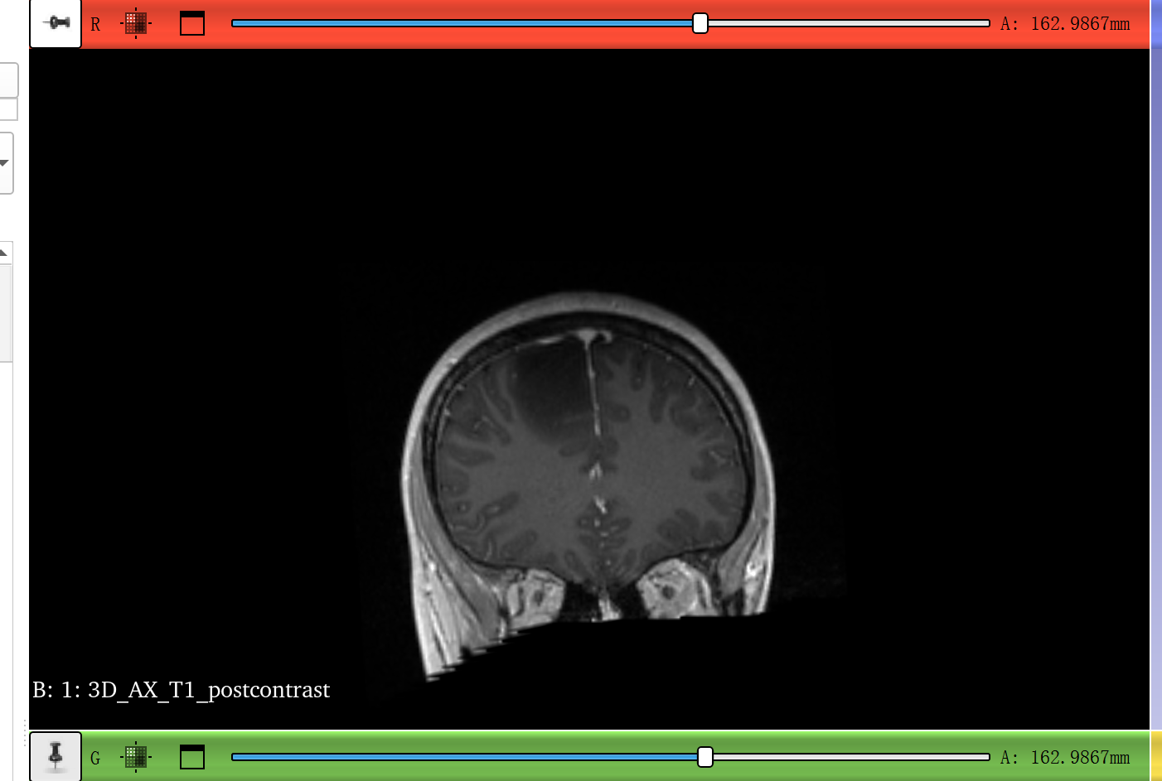
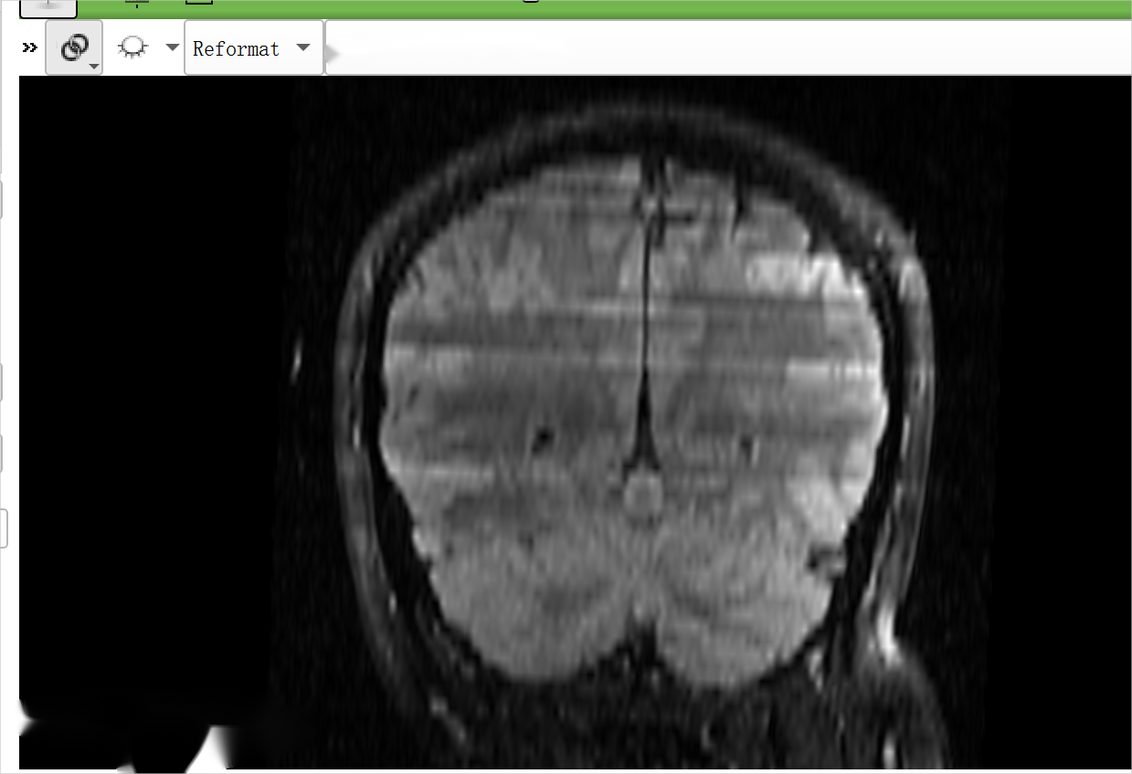
Preoperative MRI
Intraoperative MRI
The absence of clear tumor boundaries necessitates additional scanning sessions to ensure accurate localization and resection.
Poor intraoperative MRI image quality can affect the doctor's judgment of residue, prolong the time for re-scanning and prolong anesthesia.

Slide 5
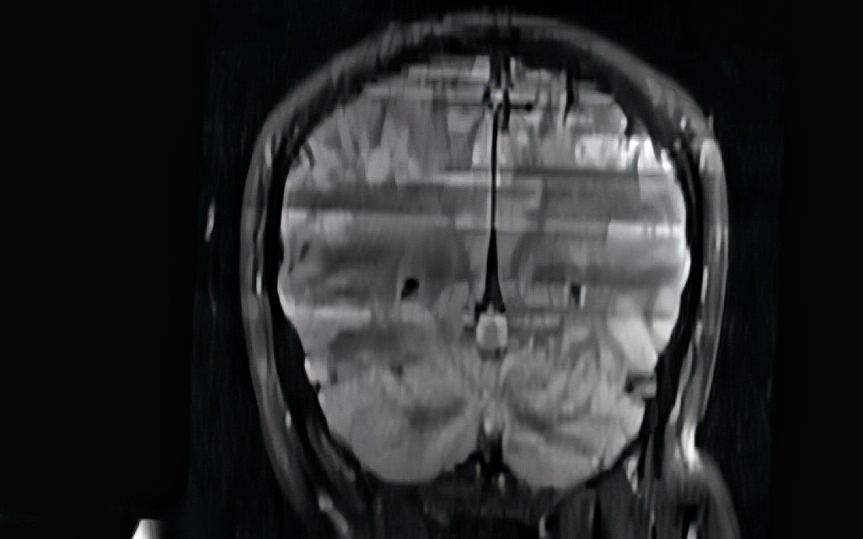
Disadvantages of traditional methods
Traditional enhancement/noise reduction:
such as smoothing and brightening the entire photo, it is easy to erase the small boundaries or paint the holes.

Slide 6
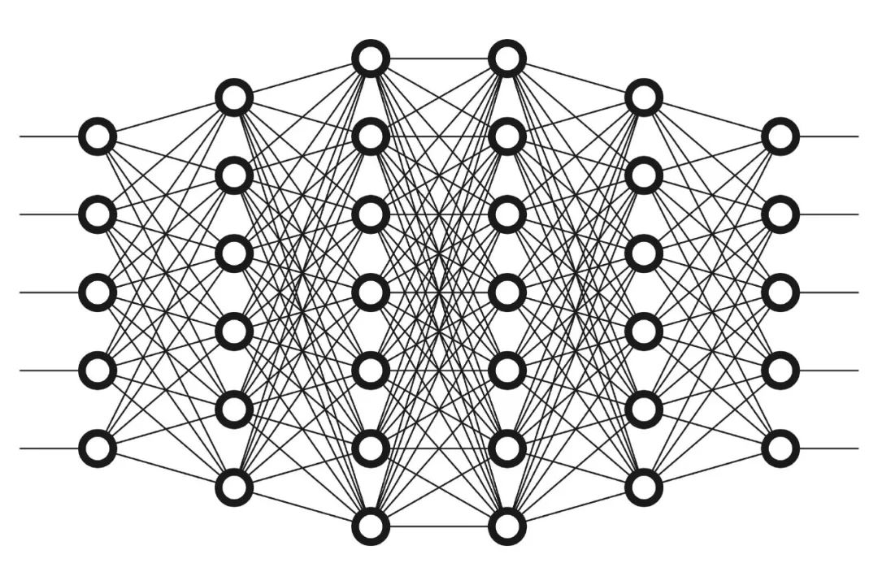
What is deep learning?
Deep learning is a technology that "teaches computers to think like humans". By imitating the working mode of the human brain, computers can learn to automatically recognize, analyze and judge from a large amount of data.
The core tool of deep learning is the neural network, which is like a "universal formula". Input data, after layer upon layer of processing, outputs the result.

Slide 7
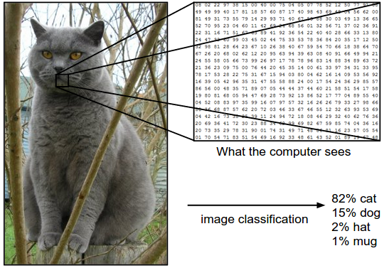
Example

Slide 8
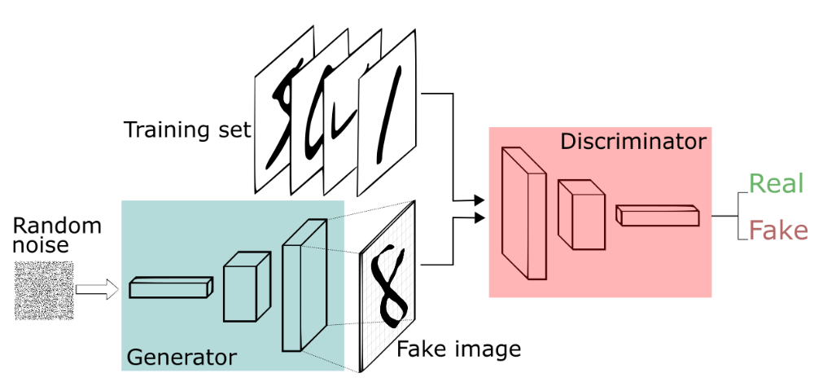
GAN ( Generative Adversarial Network )
Generator: Responsible for "creating things," such as generating a fake image of a cat.
Discriminator: Responsible for "picking faults," judging whether the image is of a real or fake cat.
Training Process:
  The generator repeatedly tries to "fool" the discriminator, improving its ability to create images that look increasingly like real cats.
  The discriminator, on the other hand, keeps getting smarter, becoming better at distinguishing between real and fake images.
  Eventually, the generator learns to create images of "cats" that are indistinguishable from real ones.

Slide 9
Proposed Methods

Slide 10

ReMIND Dataset Introduction
ReMIND dataset (The Brain Resection Multimodal Imaging Database)^{[1]} official website address: https://www.cancerimagingarchive.net/collection/remind/#citations
Juvekar, P., Dorent, R., Kögl, F., Torio, E., Barr, C., Rigolo, L., Galvin, C., Jowkar, N., Kazi, A., Haouchine, N., Cheema, H., Navab, N., Pieper, S., Wells, W. M., Bi, W. L., Golby, A., Frisken, S., & Kapur, T. (2023). The Brain Resection Multimodal Imaging Database (ReMIND) (Version 1) [dataset]. The Cancer Imaging Archive. https://doi.org/10.7937/3RAG-D070

Slide 11
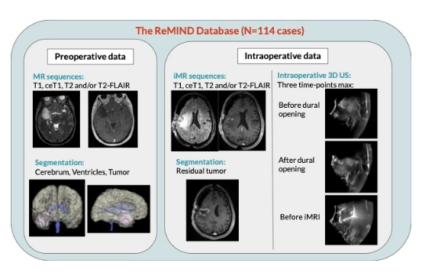
ReMIND Dataset Detailed
Data source and time:
The ReMIND dataset collected data on 114 consecutive patients treated with image-guided tumor resection before and during surgery between 2018 and 2022.
Preoperative data
MR sequences: Includes 369 MRI series, such as T1-weighted (T1), Contrast-enhanced T1-weighted (ceT1), T2-weighted (T2), T2-FLAIR
Segmentation: Whole preoperative tumor, Preoperative tumor target (specific for resection), Preoperative brain and ventricles, Previous resection cavity (if applicable)
Intraoperative data
iMR sequences: Includes 301 MRI series，
Intraoperative 3D US: Before dural opening, After dural opening, Before intraoperative MRI (iMRI)
Segmentation: Residual tumor (from intraoperative MRI), Brain and ventricles (automatically segmented)

Slide 12
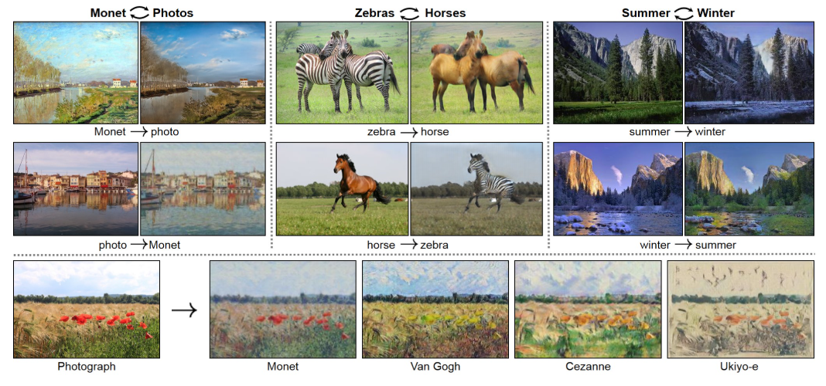
CycleGAN
"Unpaired Image-to-Image Translation using Cycle-Consistent Adversarial Networks" by Jun-Yan Zhu, Taesung Park, Phillip Isola and Alexei A. Efros proposed to solve the Image-to-Image Translation problem of unpaired images.
Main contribution:
Unpaired Image-to-Image Translation
Cycle Consistency
https://github.com/junyanz/CycleGAN

Slide 13
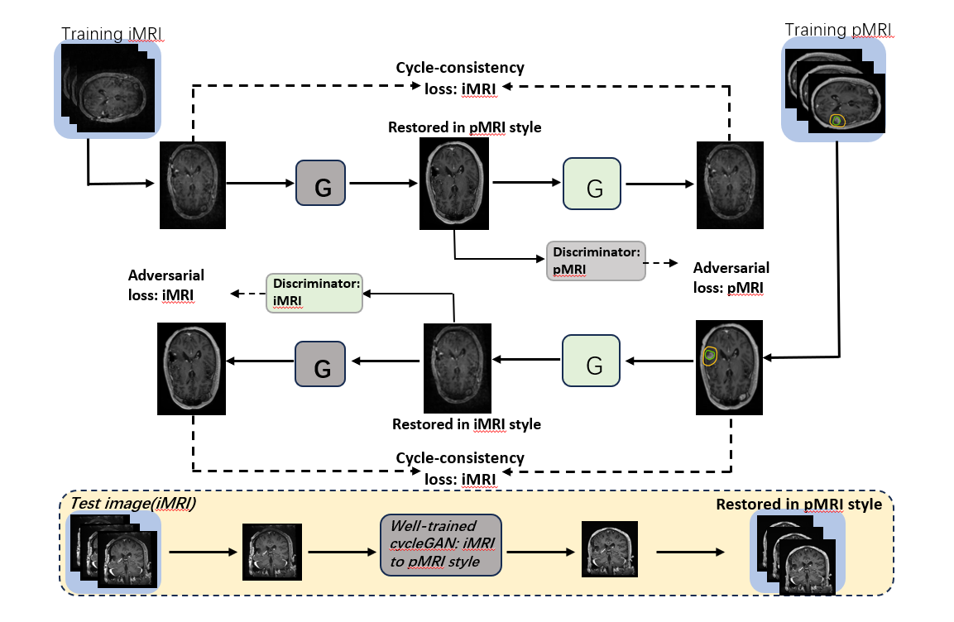
CycleGAN

Slide 14
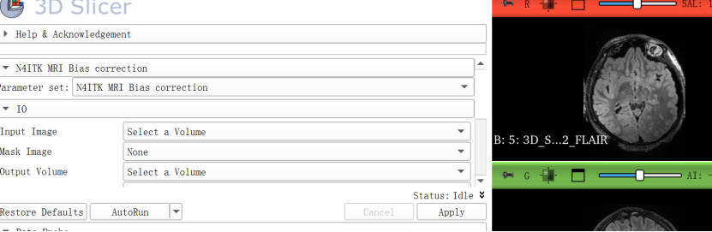
Tools and Motivation
Tools: 3D Slicer (N4 Bias Field Correction, Gaussian Smooth, General Registration).
Motivation: Although CycleGAN does not require paired registration, we perform registration and standardization before training to (i) improve cross-case visualization consistency, (ii) ensure strict spatial correspondence between masks and evaluation regions, and (iii) facilitate slice-level display and analysis.
Procedure
Bias Field Correction (N4 Bias Field Correction)
Noise Suppression (Gaussian Smooth)
Anatomical Registration
Mask Creation (Masking)
Intensity Normalization (Code)
Data Organization

Slide 15
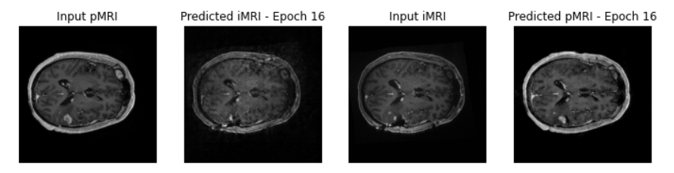
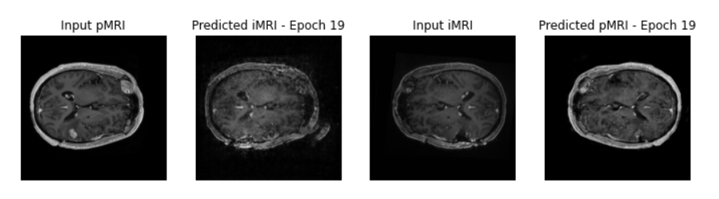
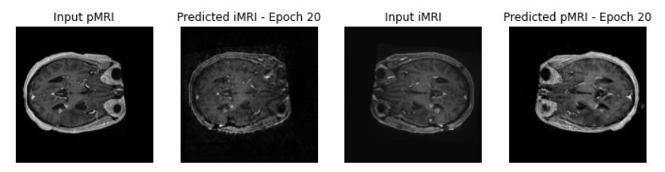
CycleGAN
Experimental results during training
https://github.com/junyanz/CycleGAN

Slide 16

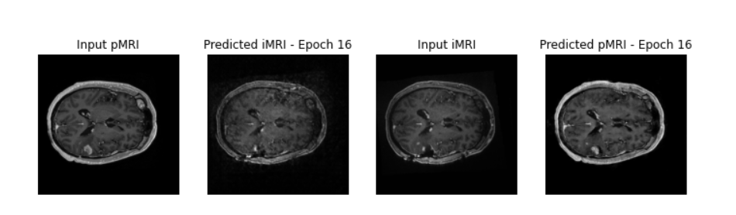
Problem!!
The tumor removed by surgery was restored？！？！
Because the essence of cycleGAN is style transfer, we need to make improvements based on this model and ignore the repaired tumor.

Slide 17
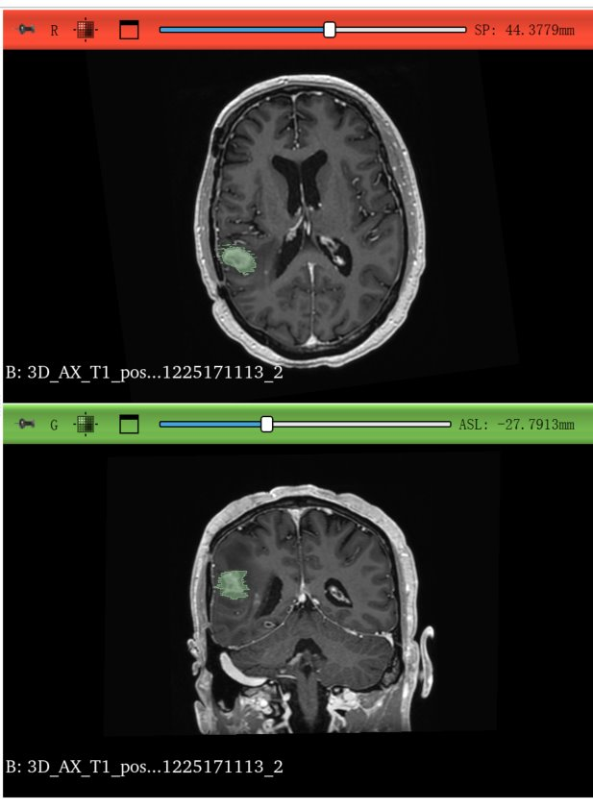
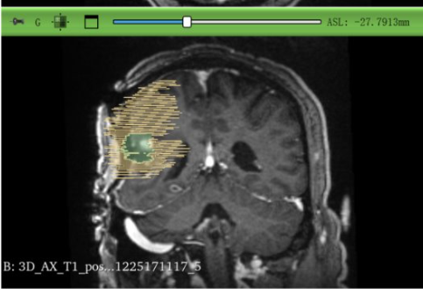
Method 1 — Add “Rules” (Mask-Guided)
Intuition
  The model doesn’t know where to learn more or less; we explicitly tell it.
Approach
  Use pre-op segmentation (registered to intra-op) to create two weight maps:
    Yellow ring (~5 mm peri-tumoral “critical zone”): high weight to boost sharpness/contrast/boundaries.
    Green region (resection cavity/tumor area): suppression λg≈0.3 to prevent hallucinating tumor.
  Integrate weights into all key losses and critics: adversarial, cycle/reconstruction, perceptual/style, and discriminator scoring.
Outcome
  Optimization focuses on clinically critical anatomy; false tumor regeneration in the green region is strongly reduced.

Slide 18
GAN ( Generative Adversarial Network )
Generator: Responsible for "creating things," such as generating a fake image of a cat.
Discriminator: Responsible for "picking faults," judging whether the image is of a real or fake cat.
LOSS ?

Slide 19
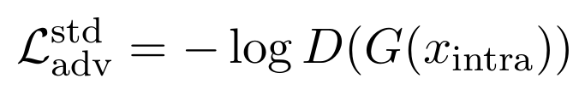


LOSS
Adversarial Loss

Slide 20



LOSS
2. Reconstruction Loss

Slide 21
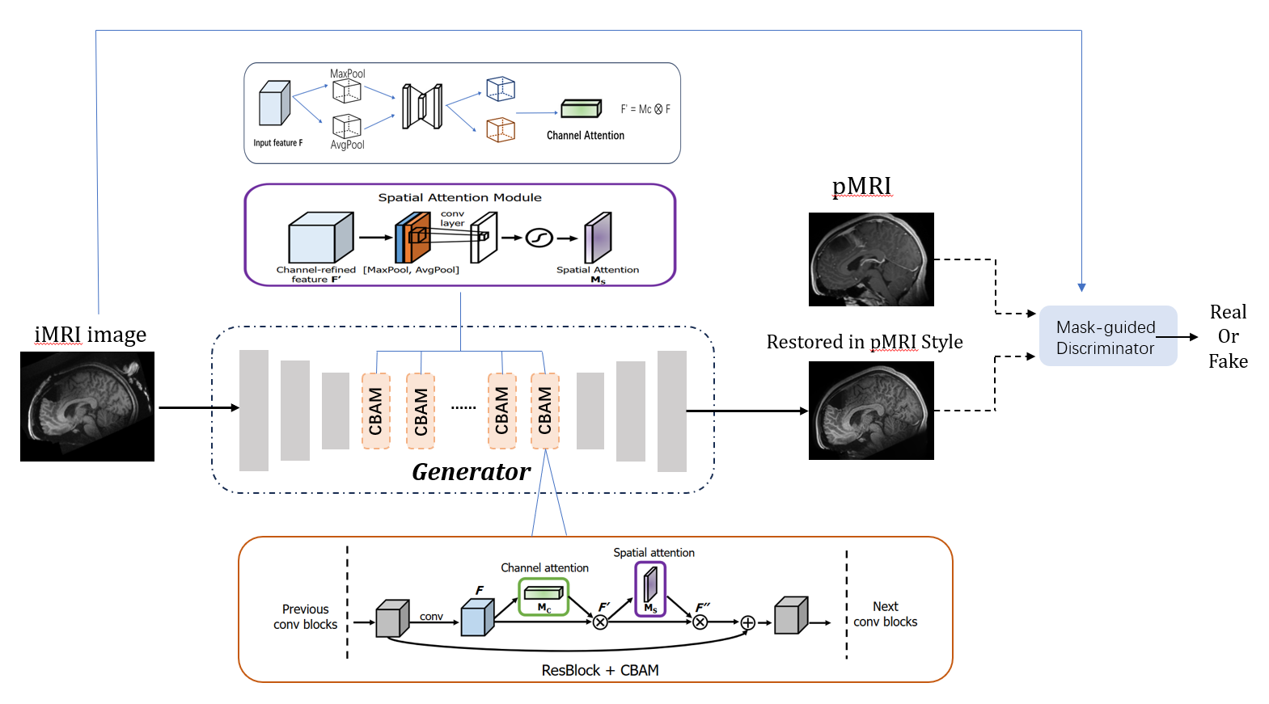
Method 2 — Add “Attention” (CBAM Learns Where to Look)
Rules help, but the network must also allocate attention efficiently.
Insert CBAM after each encoder/decoder residual block (channel + spatial attention).
Feed the masks as hints to attention: more focus in the yellow ring, conservative in the green region.
Smarter feature extraction; more localized quality gains; smoother, more natural boundaries.

Slide 22
Results and Metrics Analysis

Slide 23
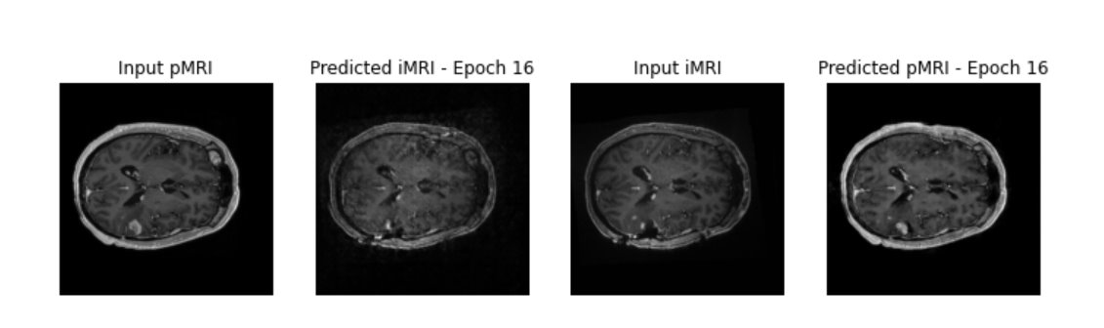
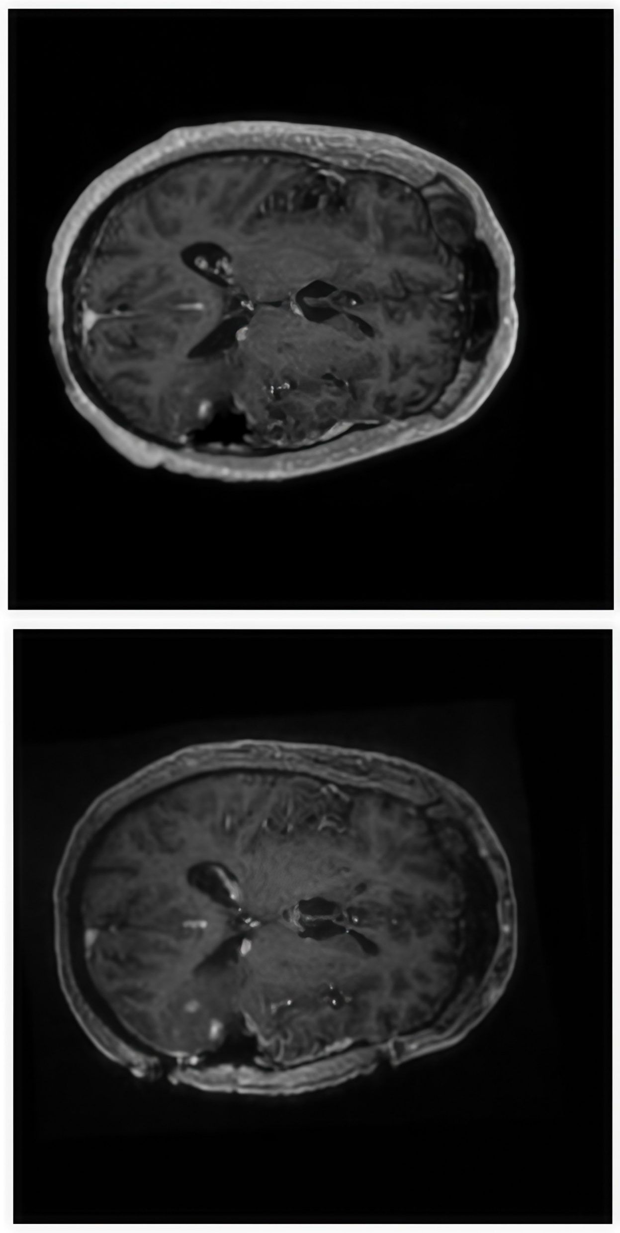
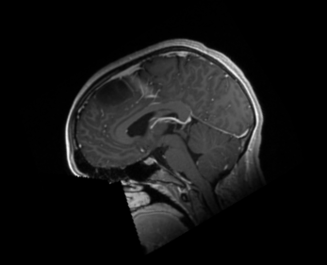
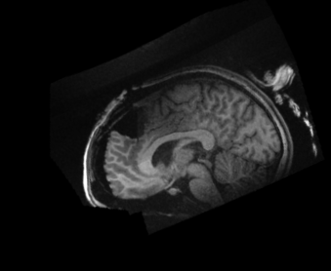
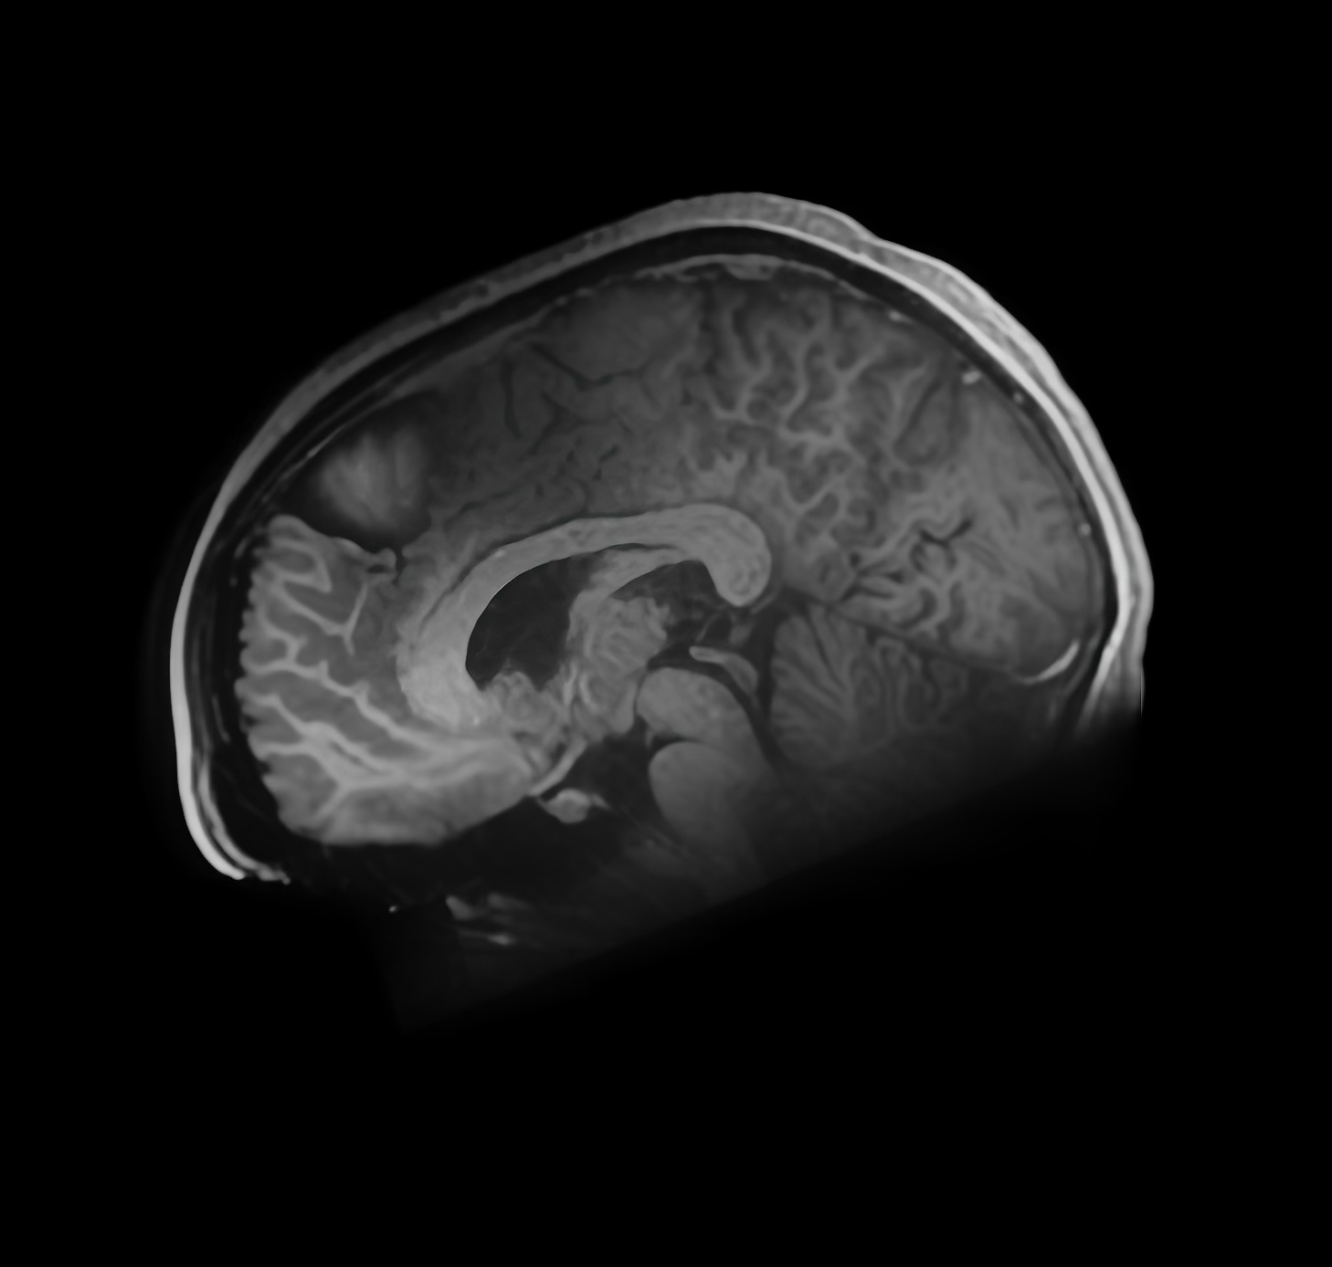
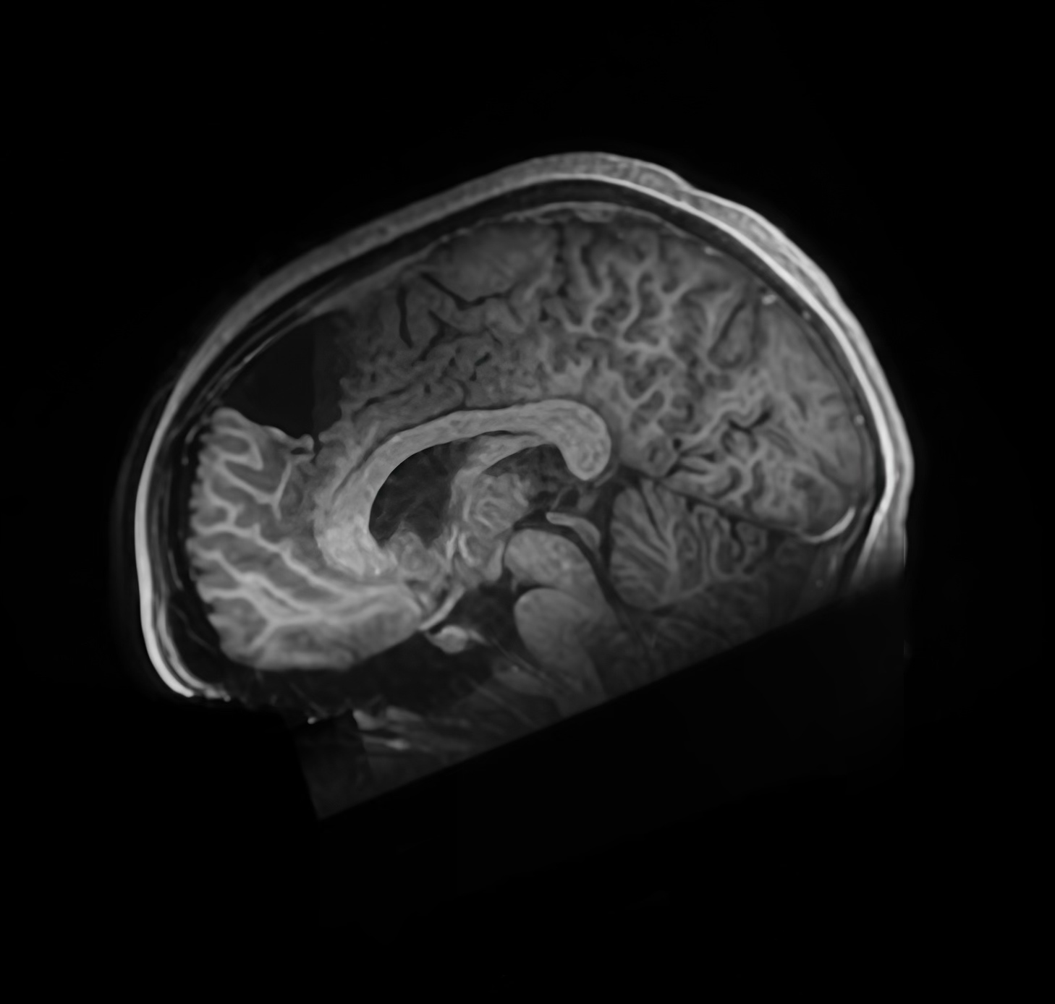
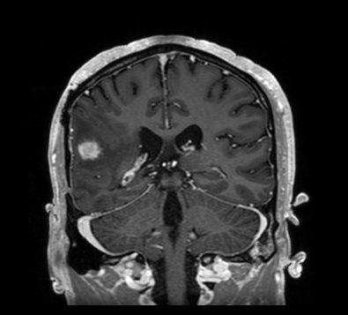
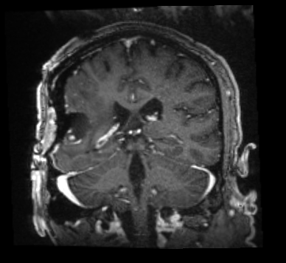
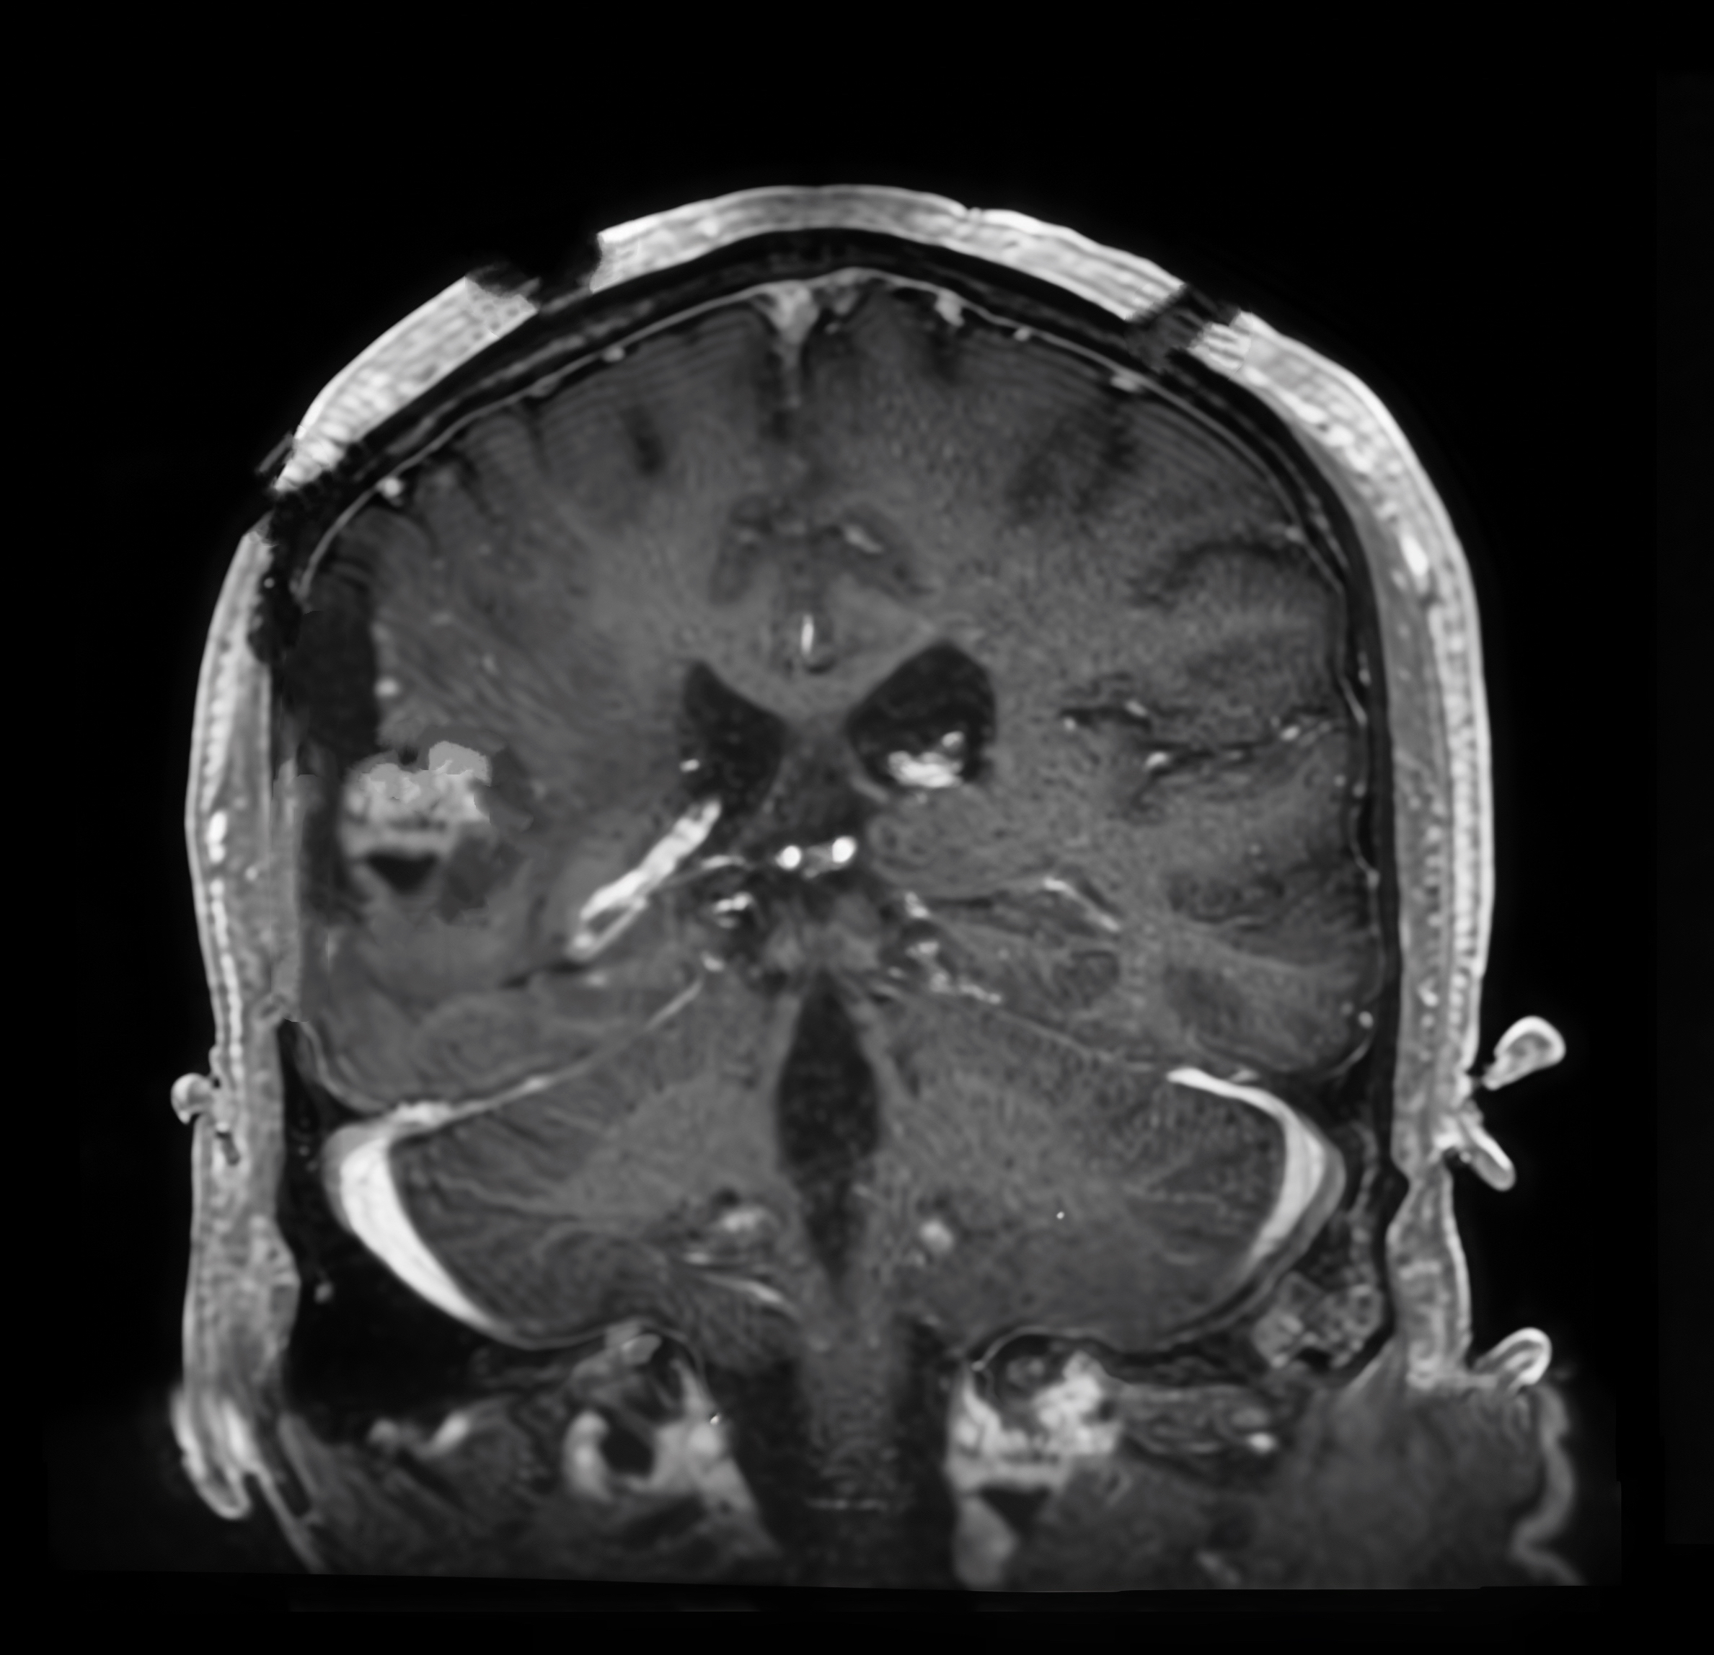
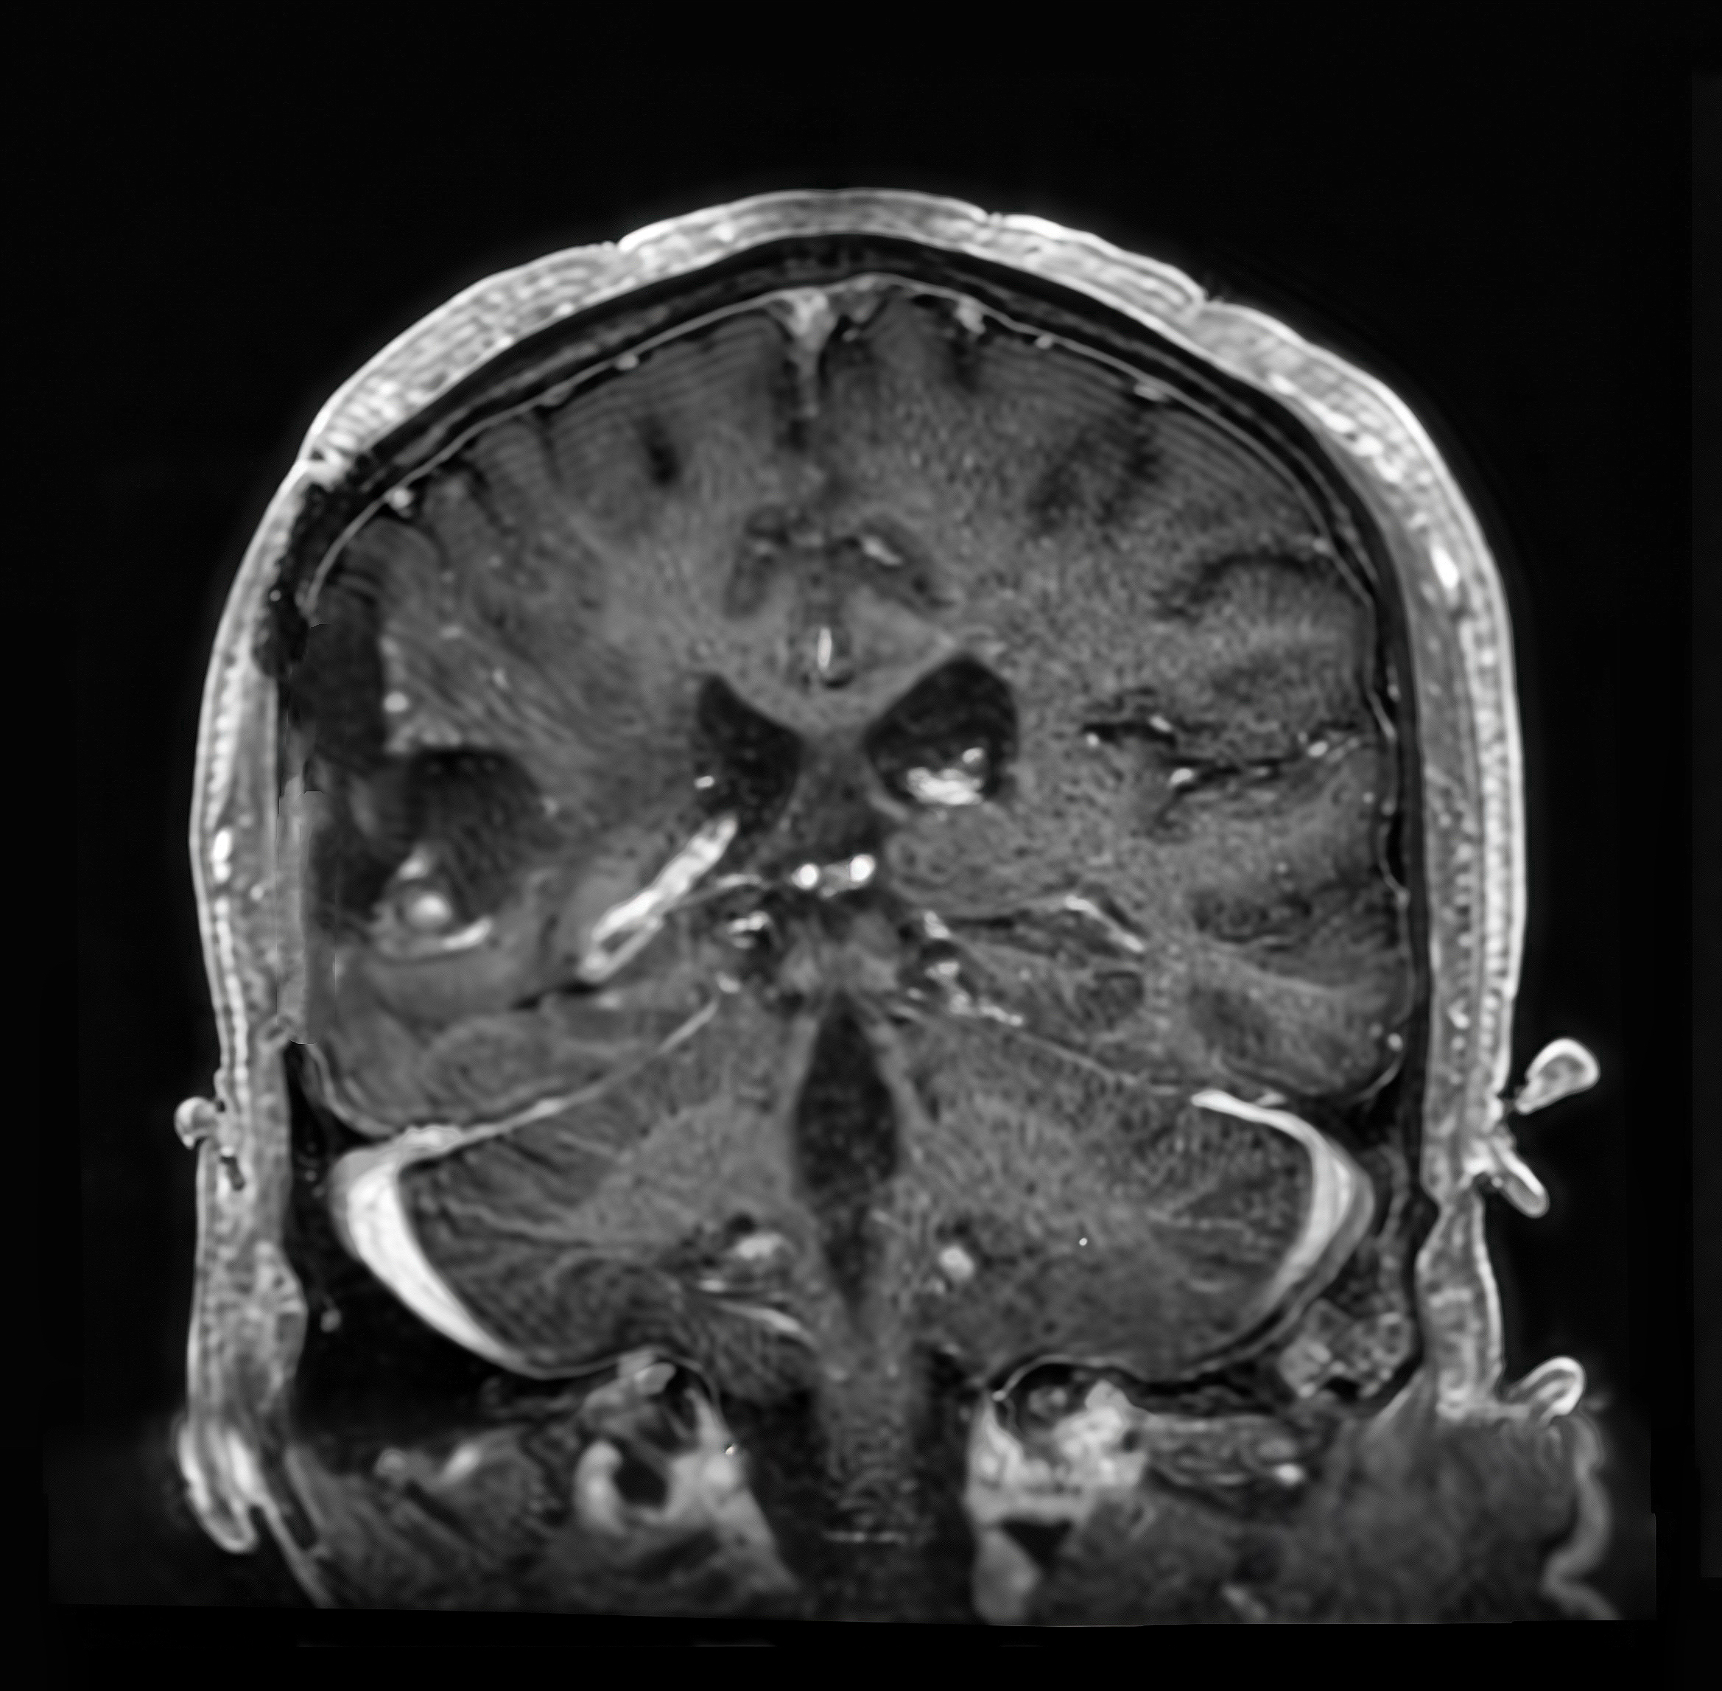
Input pMRI
Input iMRI
Traditional CycleGAN generated
Surge-aware GAN generated

Slide 24
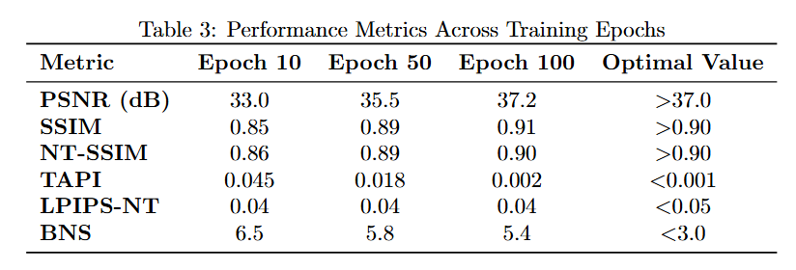
Performance
PSNR (↑): “Signal-to-noise” for images. Higher PSNR means the enhanced image is closer to the clean reference in brightness and details, with less noise. Above ~37 dB is typically considered very clean.
SSIM (↑): “Structure preservation” score. It checks not only brightness but also contrast and spatial relationships of textures. Values >0.90 indicate that major structures and texture relations are well preserved.
NT-SSIM (↑): Non‑Tumor SSIM. The same idea as SSIM but computed only in healthy tissue. Think of it as “do surgeons’ normal brain structures remain unchanged?” Values >0.90 mean normal anatomy is well preserved.

Slide 25
Performance
PSNR / SSIM / NT-SSIM (higher is better): Do we preserve clarity and anatomical structure well, especially in non‑tumor regions?
LPIPS‑NT (lower is better): Does it look perceptually similar to the reference to a human observer in non‑tumor regions?
TAPI (lower is better): Are tumor/cavity areas kept intact without being mistakenly “restored” or filled in?
BNS (lower is better): Are boundaries natural, without halos or over‑sharpening around tumor/cavity edges?

Slide 26
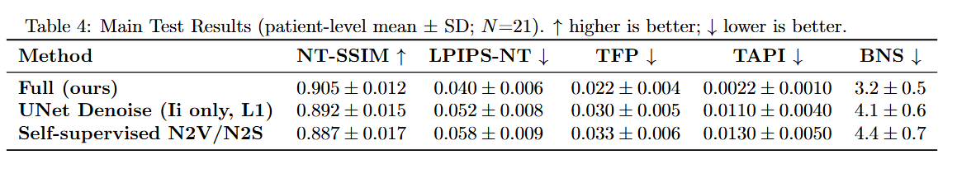
Performance

Slide 27
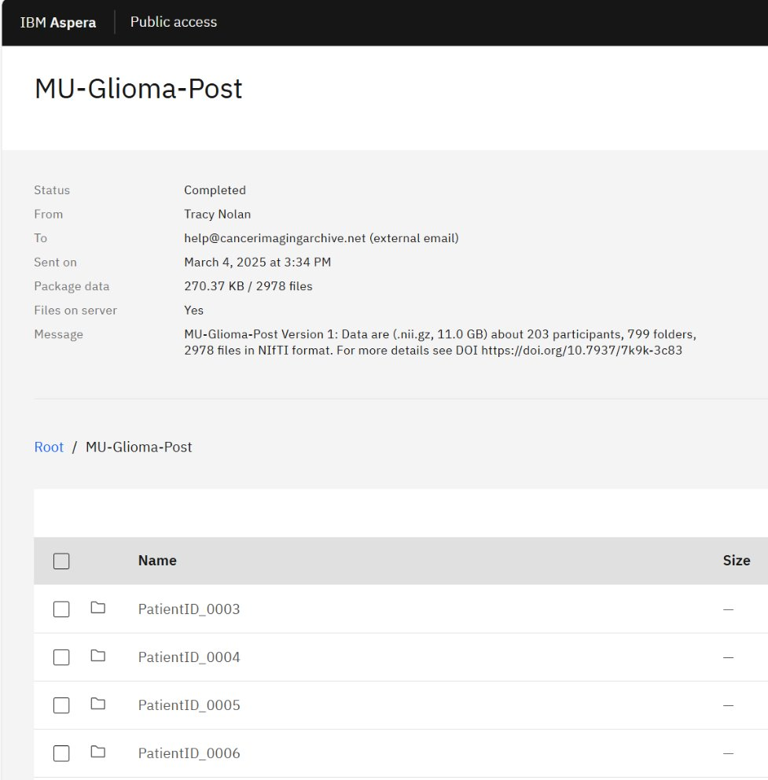
Testing ---- MU-Glioma-Post Dataset
Data source and size​
    Hosted on TCIA (NIIfTI, .nii.gz)​
    Version 1: ~203 participants, 799 folders, 2,978 files, ~11.0 GB​
    DOI: https://doi.org/10.7937/7k9k-3c83​
Imaging and labels​
    Sequences: T1, T1ce, T2, FLAIR (some cases ± DWI/ADC, SWI)​
    Annotations: residual/recurrent tumor; postoperative changes (resection cavity, hemorrhage, nonspecific enhancement)​
Key characteristic​
    Post-resection MRI with low clarity/SNR​
    Common artifacts: motion, metal-clip, thicker slices → fuzzy small lesions, unstable registration​
Intended use​
    Segmentation of residual/recurrent tumor​
    Recurrence vs pseudoprogression classification​
    Baseline: bias correction + normalization + light denoising; 3D nnU-Net with coarse-to-fine and cleanup​
Access​
    Research use; de-identified data via TCIA/Aspera download

Slide 28
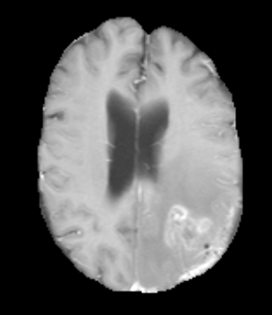
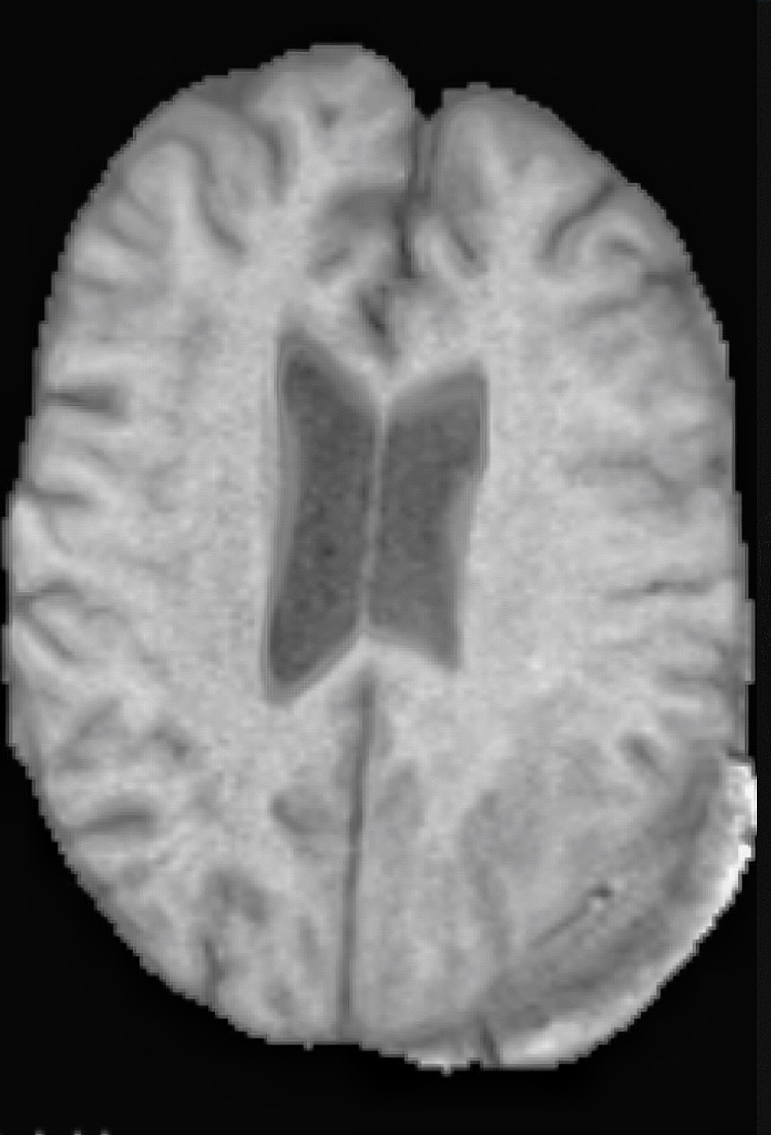
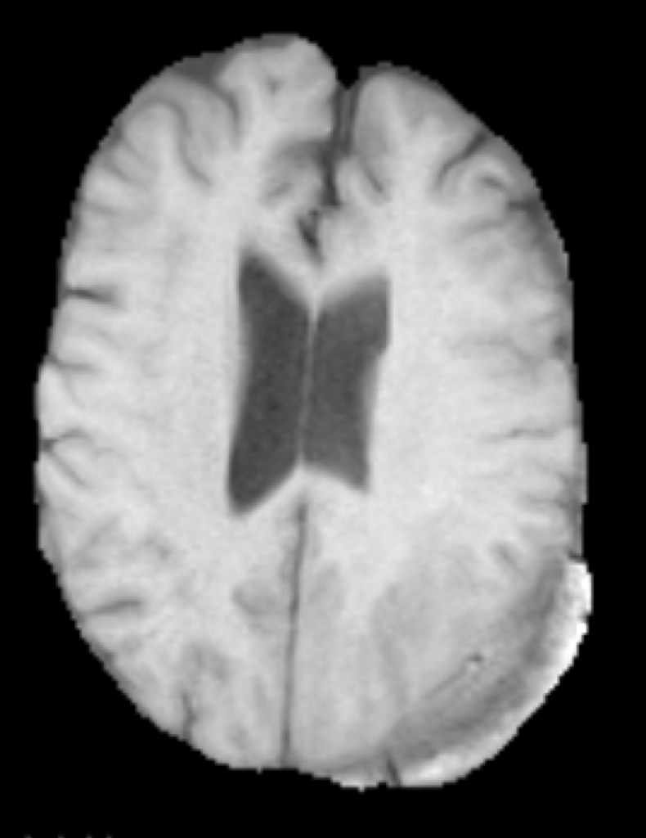
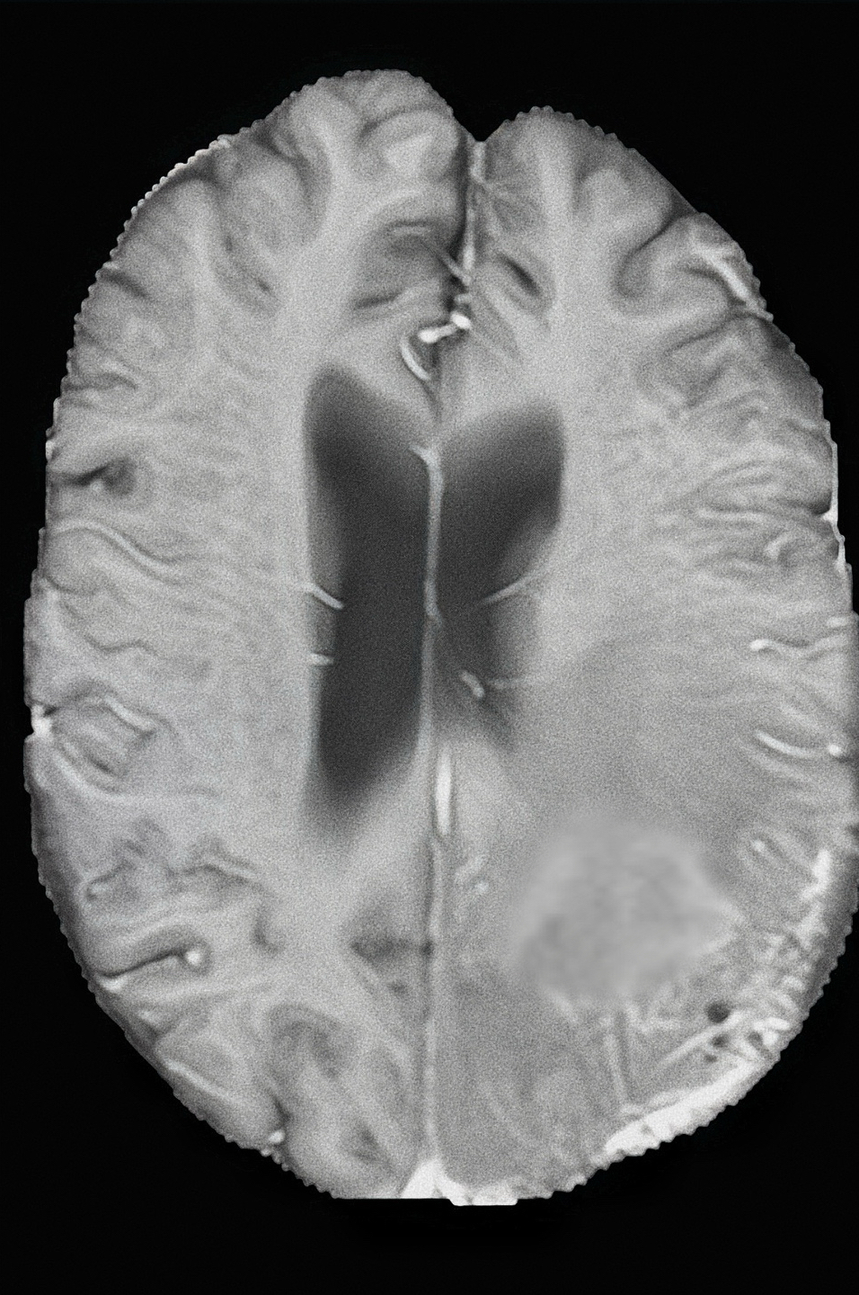
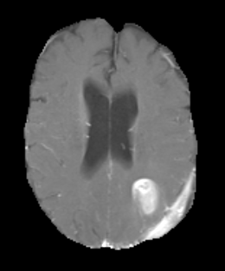
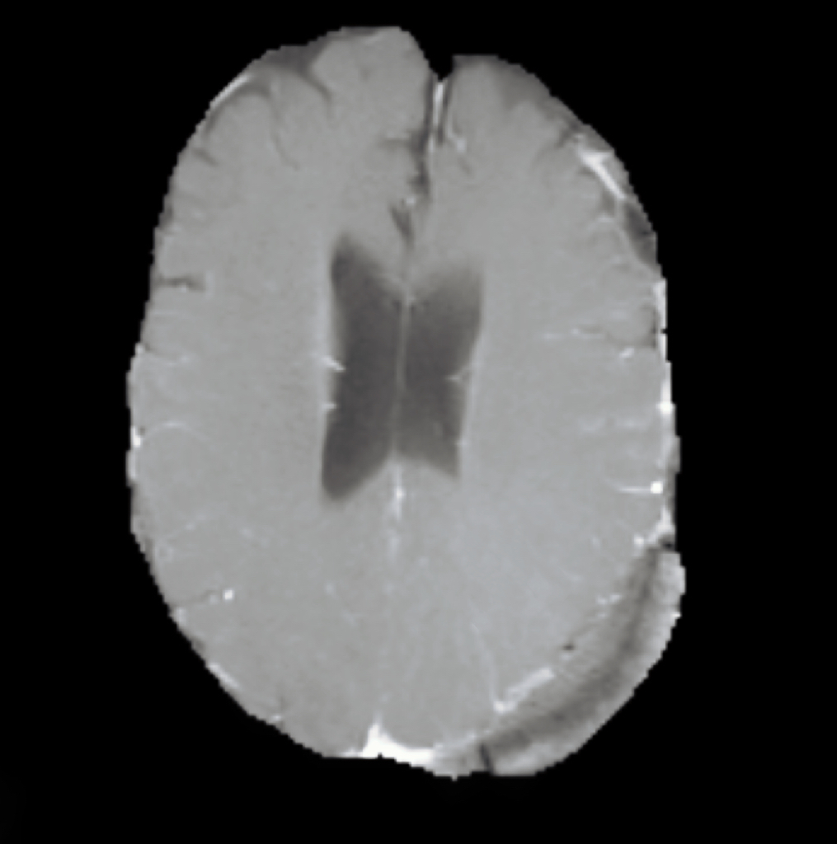
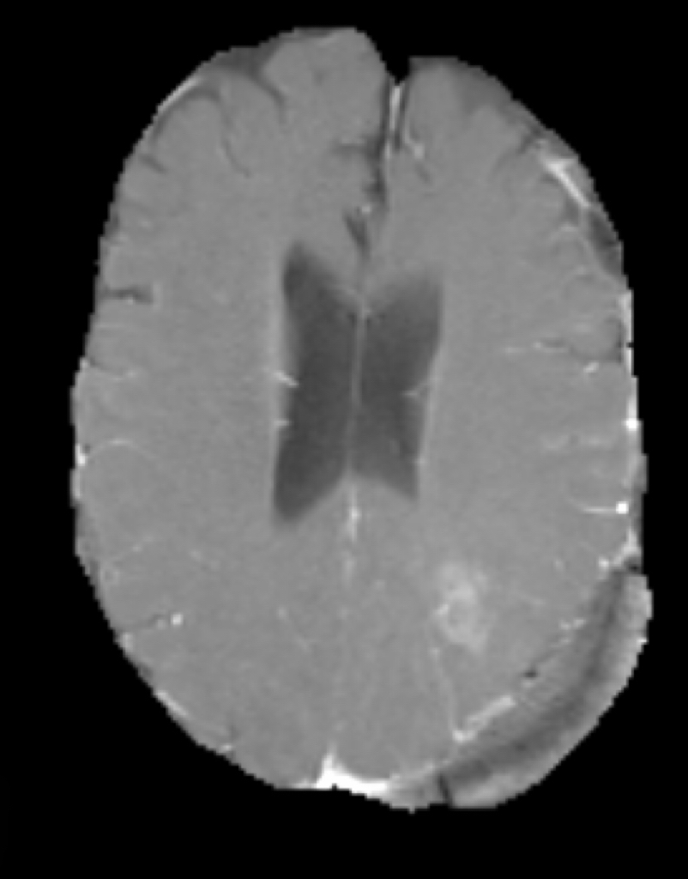
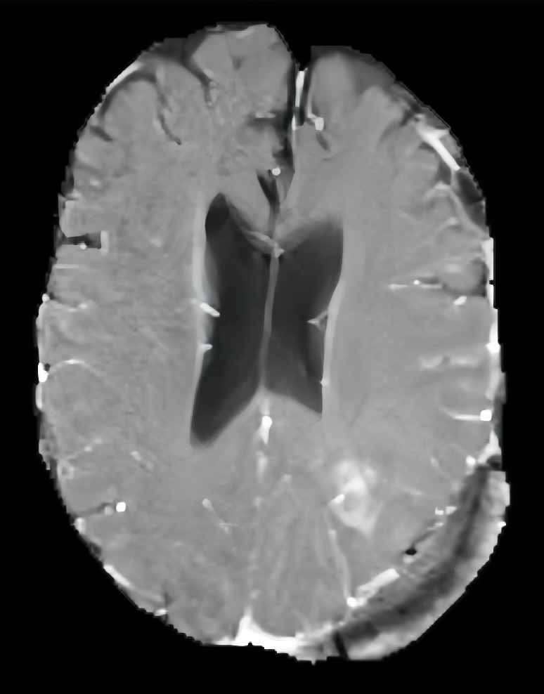
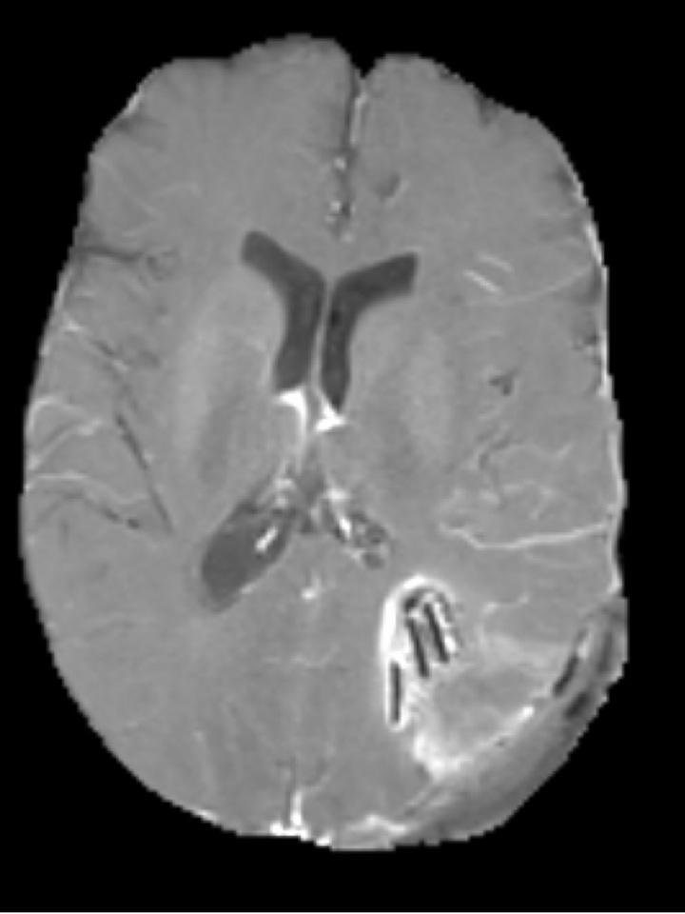
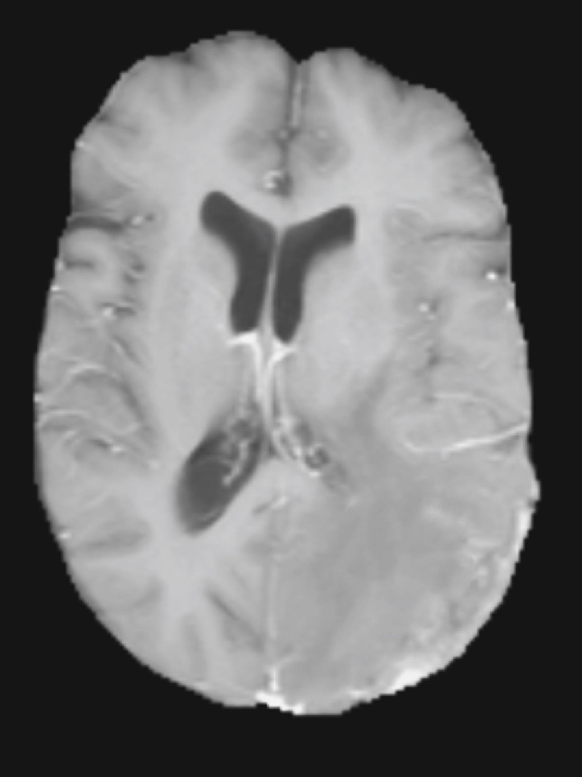
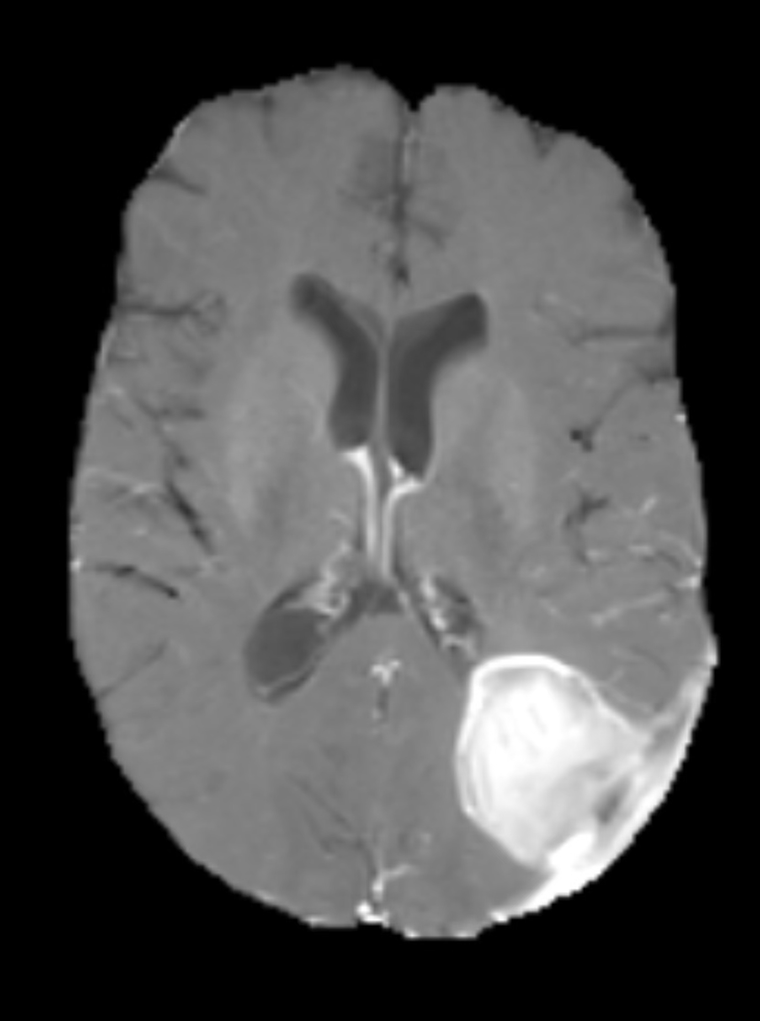
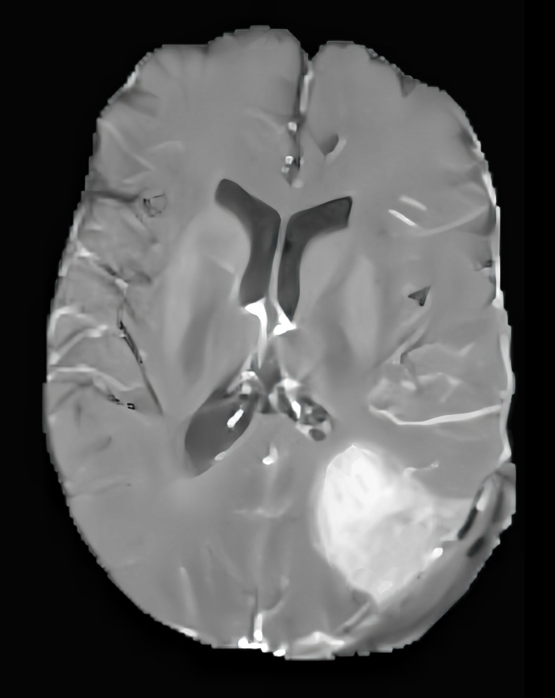
Input pMRI
Generated iMRI
Input iMRI
ATT- CycleGAN generated high quality style

Slide 29
Conclusion

Slide 30
Our surgery‑aware enhancement framework improves global image quality (PSNR/SSIM/NT‑SSIM) while markedly reducing safety‑critical errors (TAPI, BNS, LPIPS‑NT). It maintains consistent advantages on the external MU‑Glioma‑Post test set, demonstrating clinical robustness and scalability.

Slide 31
Future Work
Replace fixed λ with learnable/adaptive weights, possibly driven by uncertainty or case difficulty, to reduce hyperparameter sensitivity.

